Slide 1
Java Programming
Standard Input & output

Slide 2
CalcArea.java
What’s wrong with this program? how to improve it?
package hit.edu.java.intro;
public class CalcArea {
public static void main(String[] arguments) {
float r = 12.0F;
String str = “The circular area with radius ”;
str = str + r + “ is: ”;
str = str + 3.1415926*r*r;
System.out.println(str);
}
}
Notes:
本次课解决这个示例中的两个问题：（1）死的程序，不能输入；（2）输出结果小数点后保留的位数过多，不美观

Slide 3
Outline
Standard input & output
Standard Output
Formatting output
Standard Input
java.util.Scanner
Import statement
Package & Fully qualitied name
Scanner Bug
class library
Math
Magic number & Constant

Slide 4
Standard input & output
Generally input is being given with the keyboard, and output is displayed on your screen.
Your keyboard is your "standard input" device, and the screen is the "standard output" device.

Slide 5
System.out.println
We saw these statements in previous chapter:
System.out.println(“Hello World!”)
System.out.println(10.5+(3-1)/(1+1));
This method can output everything!
What is System ?
What is System.out ?
What is System.out.println ?

Slide 6
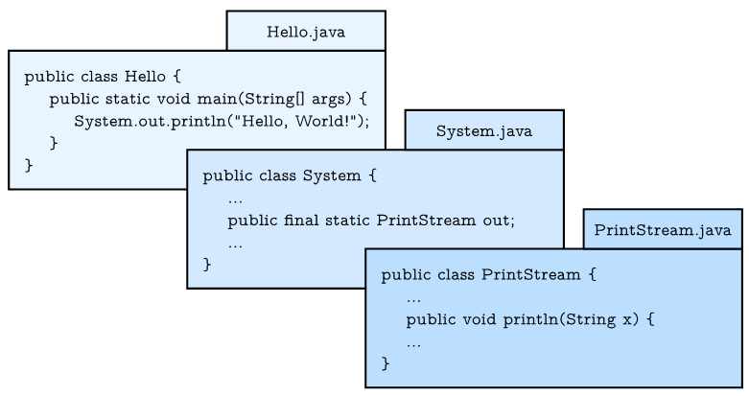
System.out.println

Slide 7
Class(类)
Class is a type, but not a primitive type.
Class is a collection of attributes and methods (or subroutines)
Attributes are variables that can be accessed by the methods in the same class directly.
Java use dot notation to access the attributes and methods.
When a class contains static attributes or subroutines, we can access the static attributes or subroutines without declaration!

Slide 8
System.out.println
Explanation:
Class System and PrintStream are provided by Java Library.
out is a static attribute of class System, and has the type PrintStream, we can use dot notation System.out to access it.
println is a method of class PrintStream. Similarly, we cam use dot notation System.out.println to invoke it.

Slide 9
Formatting output(格式化输出)
When you output a double using print or println, it displays up to 16 decimal places:
System.out.print(4.0 / 3.0);
The result is:
1.3333333333333333

Slide 10
Formatting output
System.out provides another method, called printf, that gives you more control of the format. The “f” in printf stands for “formatted”. Here’s an example:
System.out.printf("Four thirds = %.3f", 4.0 / 3.0);
This format string contains ordinary text followed by a format specifier, which is a special sequence that starts with a percent sign. The result is:
Four thirds = 1.333

Slide 11
CalcArea.java (modified)
package hit.edu.java.intro;
pubic class CalcArea {
public static void main(String[] arguments) {
float r = 12.0F;
String str = “The circular area with radius ”;
str = str + r + “ is %.3f\n”;
System.out.printf(str, 3.1415926*r*r);
}
}

Slide 12
Format specifiers(格式控制符)
Complete Form:
% [flags] [width] [.precision] conversion-character
Conversion code, e.g., %d for integer, %f for floating-point number, %c for character and %s for string.
Optional width can be inserted in between to specify the field-width.
Optional flag(-) can be used to control the alignment (default to the right, - means to the left).

Slide 13
Format specifiers
Note:
%α.βf is used to format the floating point number (float or double) printed in α spaces with β decimal digits (α and β are optional).
%n means a system-specific new line (Windows uses "\r\n", Unix and Mac "\n").

Slide 14
Observe the results
System.out.printf("1234%3d6789%n", 5);
System.out.printf("1234%-3d6789%n", 5);
System.out.printf("Hi,%s%n", "Trump!");
System.out.printf("Hi,%5s%n", "Trump!");
System.out.printf("Hi,%.5s%n", "Trump!");
System.out.printf("It’s %8.2f%n", 66.6666);
System.out.printf("It’s %.3f%n", 66.6666);
System.out.printf("It’s %d%n", 66.6666);
System.out.printf("%s is %d%n", 70, "Trump");
Notes:
注意四舍五入
最后一个输入参数错误IllegalFormatConversionException

Slide 15
Demo
Formatting output

Slide 16
Input
The System class also provides the special value System.in, which is an InputStream that provides methods for reading input from the keyboard.
These methods are not easy to use; fortunately, Java provides class Scanner make it easier to handle common input tasks: inputting strings, integers, and other data.

Slide 17
Import statement
Before we can use Scanner, you have to import it like this:
import java.util.Scanner;
The import statement tells the compiler what classes will be used.
The import statements can’t be inside a class definition. They are at the beginning of the java file.
Note: If you omit the import statement and later refer to Scanner, you will get a compiler error like “cannot find symbol”.

Slide 18
Package & fully qualified name
Here java.util is not a variable in class, it is a package that contains many classes so useful they are called “utility classes”.
Java use fully qualified name (which is also a dot notation) to access the class in different packages.

Slide 19
Package
In Java, Package serves to group related classes hierarchically and define a namespace for the classes they contain.
To specify the package a class is to be part of, you use a package directive. The package keyword, if it appears, must be the first token of Java code.
Note: the java.lang package is imported automatically, so we can use the classes without importing them.
System, String and some other classes are in this package!

Slide 20
Fully qualified name(全限定名)
Every class has both a simple name, which is the name given to it in its definition, and a fully qualified name, which includes the name of the package of which it is a part.
The String class, for example, is part of the java.lang package, so its fully qualified name is java.lang.String.

Slide 21
Fully qualified name
The only way to use classes that belong to other packages without importing them is to use the fully qualified names of the classes in your code.
For example, the following code declares the java.io.File class using its fully qualified name.
java.io.File file = new java.io.File(filename);

Slide 22
Fully qualified name
If your class import identically-named classes from different packages, you must use the fully qualified names when declaring the classes.
For example, the Java core libraries contain the classes java.sql.Date and java.util.Date. In this case, you must write the fully qualified names of java.sql.Date and java.util.Date to use them.

Slide 23
HelloSomeone.java
package edu.hit.java.intro;
import java.util.Scanner;
public class HelloSomeone{ public static void main(String[] arguments) { Scanner in = new Scanner(System.in); String yourName= in.nextLine(); System.out.println(“Hello, ” + yourName); } }

Slide 24
CalcArea.java (modifed)
package edu.hit.java.intro;
import java.util.Scanner;
public class CalcArea{ public static void main(String[] arguments) { Scanner in = new Scanner(System.in); System.out.println(“what is the radius?”); float r = in.nextFloat(); String str = “The circular area with radius ”; str = str + r + “ is: %.3f\n”; System.out.printf(str, 3.1415926*r*r); } }

Slide 25
java.util.Scanner
Here we declare a Scanner variable named in and creates a new Scanner that takes input from System.in which presents the keyboard.
Scanner provides a method called nextLine that reads a line of input (a string that ends with \n) from the keyboard and returns a String.
Scanner also provides a method called nextFloat that reads a float number from the keyboard.
NOTE:
If we want to access the non-static attributes and methods, we must use the keyword new followed by a call to the class's constructor to instantiate an object, then use the dot notation to invoke them.

Slide 26
Magic numbers(魔数)
The numbers like 3.1415926 appear in expression is called magic number.
If the same value appears many times, and might have to change in the future, it makes code hard to maintain.
A good practice is to assign magic numbers to constants with meaningful names.

Slide 27
CalcArea.java (modified)
package edu.hit.java.intro;
import java.util.Scanner;
public class CalcArea{ public static void main(String[] arguments) { final double PI = 3.1415926; Scanner in = new Scanner(System.in); System.out.println(“how many inches?”); float r = in.nextFloat(); String str = “The circular area with radius ”; str = str + r + “ is %.3f\n”; System.out.println(str, PI*r*r); } }

Slide 28
Constants(常量)
Variables declared as final are called constants. Constants cannot be reassigned once it has been initialized.

Slide 29
The Scanner bug
System.out.print("What is your name? ");
String name = in.nextLine();
System.out.print("What is your age? ");
int age = in.nextInt();
System.out.printf("Hello %s, age %d\n", name, age);
Hello Grace Hopper, age 45

Slide 30
The Scanner bug
System.out.print("What is your age? ");
int age = in.nextInt();
System.out.print("What is your name? ");
String name = in.nextLine();
System.out.printf("Hello %s, age %d\n", name, age);
What is your name? Hello , age 45

Slide 31
Behind the Scanner
A Scanner breaks its input into tokens using a delimiter pattern, which by default matches whitespace.
The default whitespace delimiter (空白分隔符) used by a scanner is as recognized by Character.isWhitespace.
e.g. space, tab, enter, line-feed(换行符) and form-feed(换页符).
The input source can be standard input device, a text file or a string.
Notes:
System.out.println(java.lang.Character.isWhitespace(‘\t’));//制表符
System.out.println(java.lang.Character.isWhitespace(‘ ’));//空格符
System.out.println(java.lang.Character.isWhitespace(‘\r’));//回车符
System.out.println(java.lang.Character.isWhitespace(‘\n’));//换行符
System.out.println(java.lang.Character.isWhitespace(‘\f’));//分页符

Slide 32
Behind the Scanner
create a Scanner object using different input sources
Scanner(InputStream source)
Constructs a new Scanner that produces values scanned from the specified input stream.
System.in belongs to InputStream
Scanner(String source)
Constructs a new Scanner that produces values scanned from the specified string.
Scanner(File source)
Constructs a new Scanner that produces values scanned from the specified file.
Notes:
System.in是InputStream类型

Slide 33
Behind the Scanner
Frequently used methods in Scanner
next //get a String token
nextLine //get a String line
nextInt //get a int token
nextshort //…
nextLong
nextDouble
nextFloat
nextBlooean
nextByte
…

Slide 34
Behind the Scanner
The next methods first skip any input that matches the delimiter pattern, and then attempt to return the next token.
The resulting tokens then be converted into values of different types.
The next methods may block waiting for further input.
Notes:
scanner工作原理
如果从键盘输入，Scanner拥有一个缓冲区buffer用于接受输入
next, nextInt, nextLine等方法后，如果不敲回车，将一直处于输入状态
回车后，后续的next, nextInt等方法将自动根据分隔符获得后一个token, 如果没有可用token，则处于输入状态，如果有token则无需用户输入
他们判断是否是一个token具有如下条件：在获得一个token前，如果遇到分隔符（whitespace或tab或enter则忽略），遇到token后，再以碰到分隔符作为token读入结束

Slide 35
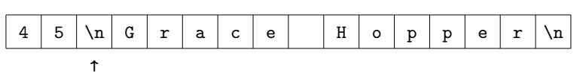
The Scanner bug
nextInt reads a token until it gets to a delimiter(分隔符), e.g. space, tab, enter, line-feed(换行符) and form-feed(换页符).
But it does not read the last delimiter.
Notes:
next,nextInt等方法读入token后，结束的分隔符不读入，仍在缓冲去中

Slide 36
The Scanner bug
nextLine reads all characters until it gets to a line separator(分行符), e.g. enter, line-feed(换行符).
And it reads and throws the line separator!
Notes:
nextLine比较特别，遇到行分行符（包括回车和换行）即将行分割符前所有字符串，包括分割符（包括分行符）都读入，而不是读入单独的token，并且抛弃分行符

Slide 37
Solve the Scanner bug
System.out.print("What is your age? ");
int age = in.nextInt();
in.nextLine(); // read the newline
System.out.print("What is your name? ");
String name = in.nextLine();
System.out.printf("Hello %s, age %d\n", name, age);

Slide 38
Demo
Scanner Bug

Slide 39
Java Library(类库)
Java library has several thousand standard classes which provide frequently used functions, such as input, output, string operations, and math operations, etc.
When we need use the java library, we should import them in first, except for some frequently used classes, such as System, Math, Integer, Float, Double, Boolean, etc.

Slide 40
Math
Math is a class of package java.lang
It provide some frequent used variables and methods. Most of them are static, so we can use them without declaration.

Slide 41
Example: Math Operation
methods
Math.abs
Math.cos
Math.sin
Math.tan
Math.ceil
Math.floor
Math.log
Math.sqrt
Math.round
Math.random
Math.min
Math.max
Math.pow
…
Constants
Math.PI
Math.E

Slide 42
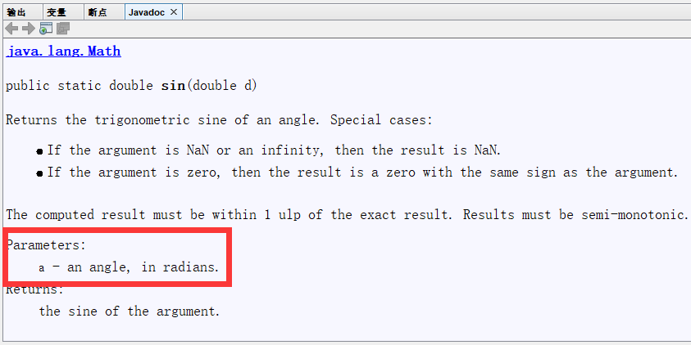


Example: Math Operation
2¹⁰=?
2²⁰=？
2³⁰=？
Sin(30。)=?
Math.pow(2,10);
Math.pow(2,20);
Math.pow(2,30);
Math.sin(30);
Math.sin(30.0/180*3.14);
Notice：We should know the meanings of parameters first, then we can use the method correctly!
Notes:
Ctrl-Shift-Space

Slide 43
CalcArea.java (final version)
package edu.hit.java.intro;
import java.util.Scanner;
public class CalcArea{ public static void main(String[] arguments) { Scanner in = new Scanner(System.in); System.out.println(“how many inches?”); float r = in.nextFloat(); String str = “The circular area with radius ”; str = str + r + “ is %.3f\n”; System.out.printf(str, Math.PI*r*r); } }

Slide 44
Example: Getting running time
long start=System.currentTimeMillis();
//write your code here
…
end=System.currentTimeMillis();
System.out.println(“your program spent "+(end-start)+"ms");

Slide 45
Example: Getting current time
package edu.hit.java.method;
import java.util.Date;
import java.text.SimpleDateFormat;
public class CurrentDate {
public static void main(String[] args) {
SimpleDateFormat df = new
SimpleDateFormat("yyyy-MM-dd HH:mm:ss");
System.out.println(df.format(new Date()));
}
}

Slide 46
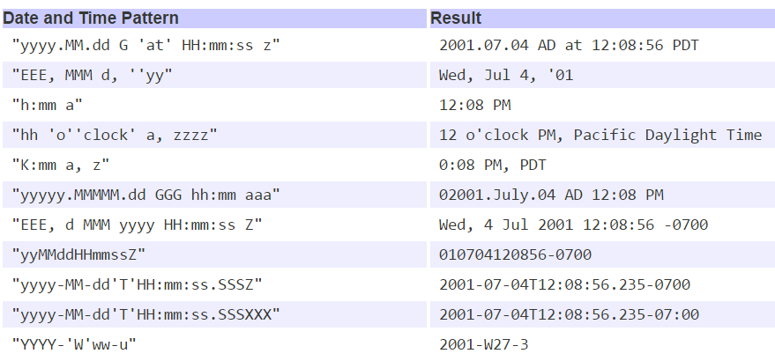
Example: Date and time pattern

Slide 47


